Slide 1
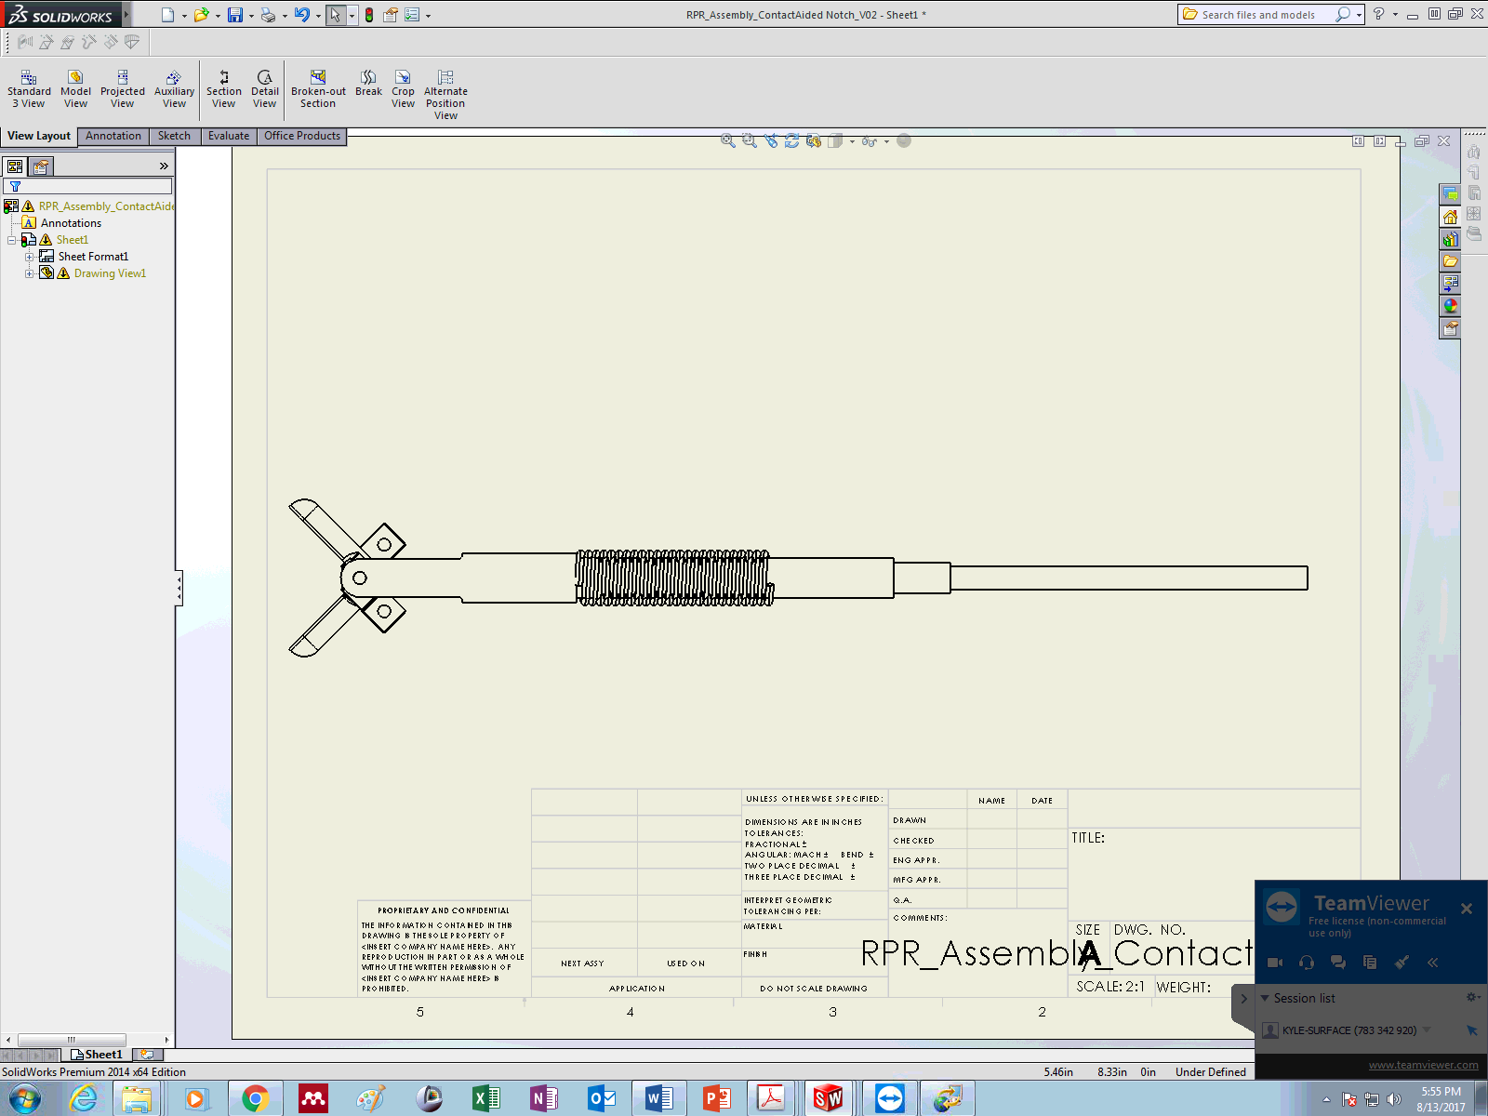
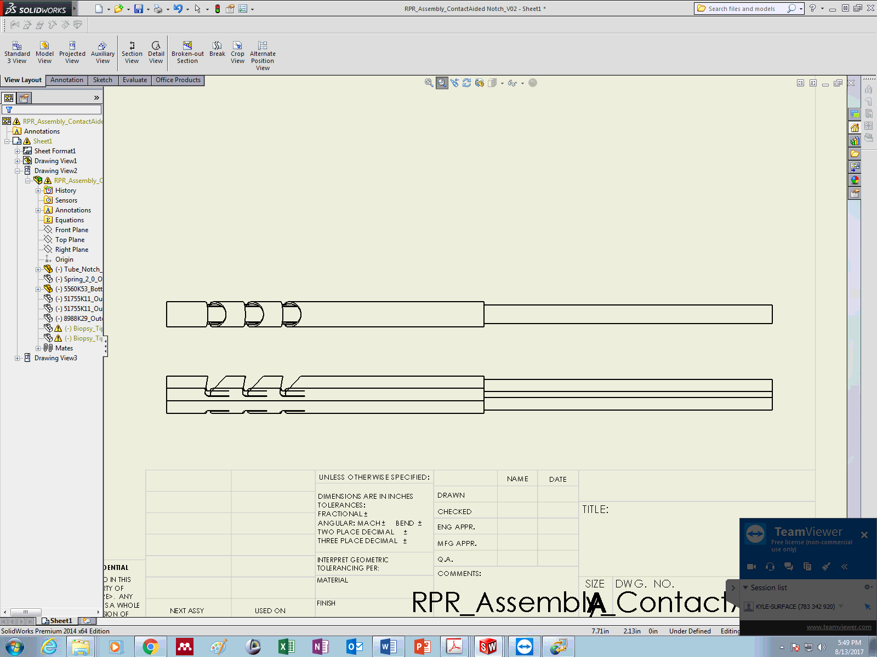
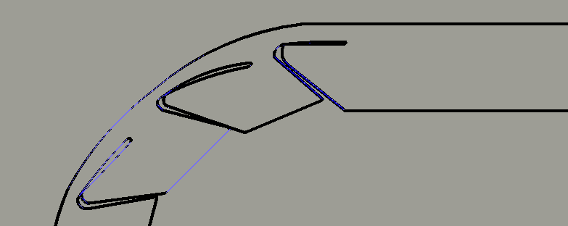


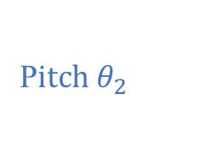

Outer Tube Assembly
Inner Tube Assembly
C₂
C_{e}
(i) Assembled (R-P-R) Wrist
Bearing Tube
Bearing Tube
Roll $θ_{3}$
Roll $θ_{1}$
End-Effector Tendon
Contact-Aided Compliant Joint Segment
C₀ ,C₁
oooooooooooooo
o
o
(ii) Assembled (R-P-R) Wrist Side-View
o
o
o
o
o
o
o
o
o
o
o
o
o
oooooooooo
o
o
o
o
o
o
C₂
o
o
o
o
o
o
P$itch θ_{2}$
o
o
Roll $θ_{1}$
o
o
oooo
o
Pitch Actuation Tendon Anchor
1 mm

Slide 2

(ii) Assembled (R-P-R) Wrist Side-View
oooooooooooooo
Roll $θ_{1}$
o
o
o
o
o
o
o
o
o
o
o
o
o
o
o
oooooooooo
o
o
o
o
o
o
o
o
o
o
o
o
o
o
o
o
oooo
o

Slide 3
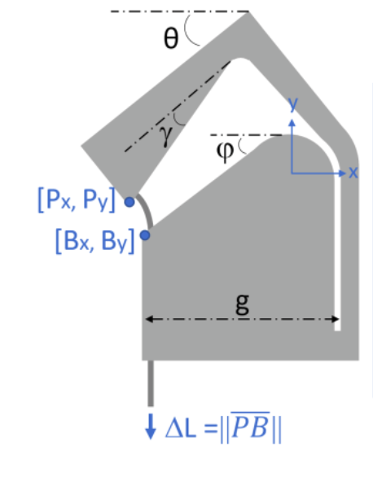
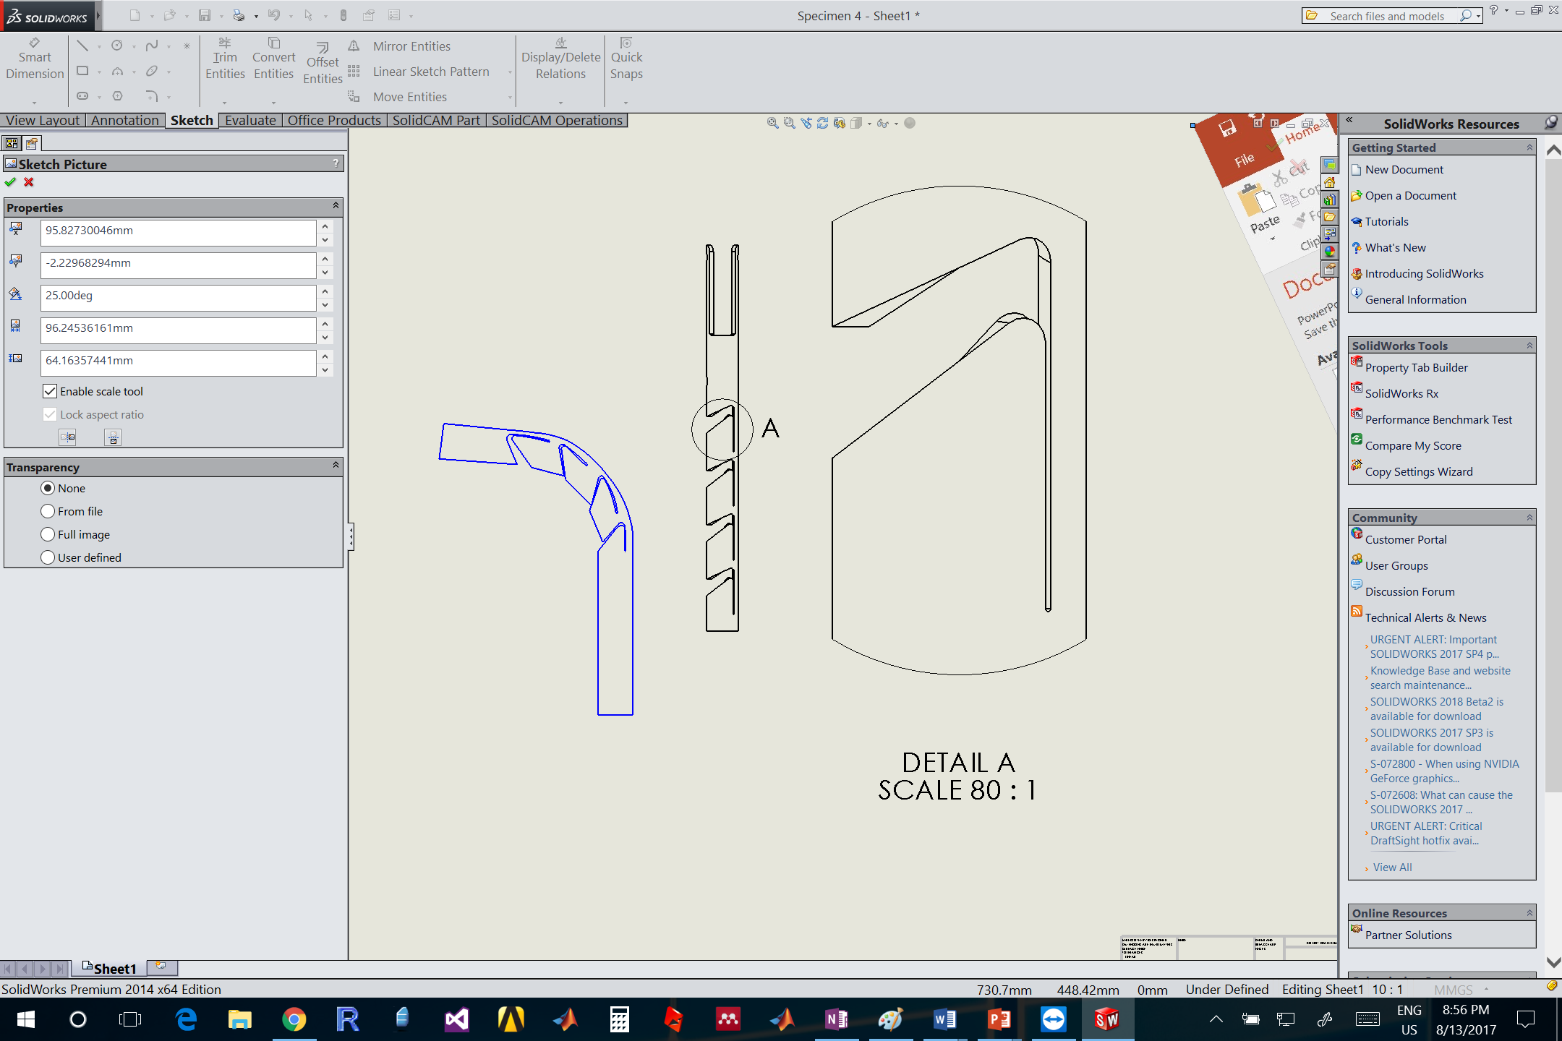
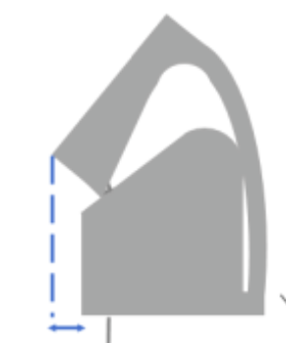











$$γ$$
A
$$S$$
$$z$$
$$z$$
$$R$$
$$x$$
$$φ$$
$$x$$
$$h$$
$$g$$
$$z$$
$$x$$
A - A

Slide 4
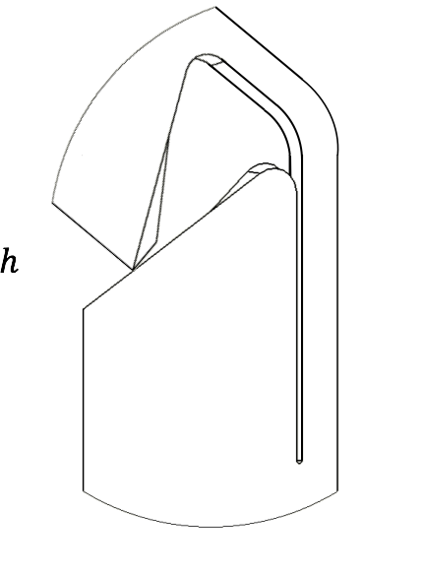

Slide 5
